Slide 1
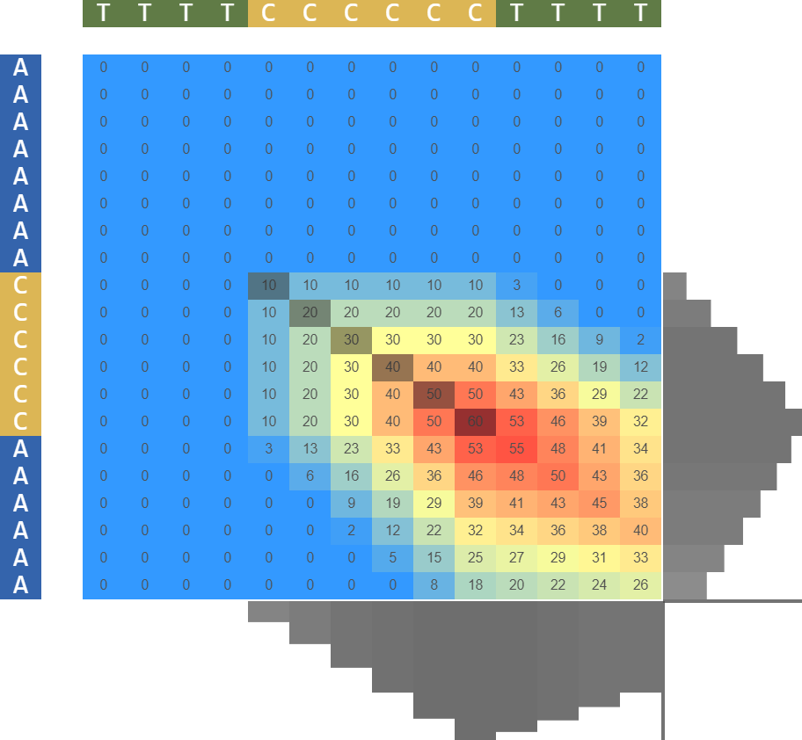
n_0
r2
x
r1
x-n_0
r1
AAAAAAAACCCCCCAAAAAA -AlignmentA |||||| -AlignmentM TTTTCCCCCCTTTT -AlignmentB
y
(c)
x
v
r2
y-n_1
y
Similarity
(d)
(b)
n_1
AGCCCTCCAGGACA-GGCTGCATCAG-AAGAGGCCATCAAGCAGGTCTGTT
||| ||| | || || |||| |||||| ||
GAAATGATCC-GGAAATTGCAGCCTCAGCCCCCAGCCATC-TGCTAACCCC
CCCCCC - AlignmentA |||||| AlignmentM CCCCCC - AlignmentB
Complementarity
(e)
(a)
GCGCTTGCTATTATCGCGCGGCGATTCAGCGTCA ||||||| ||| | ||| | GATCGGCGCGTAGCGCGGCGC---G-CGCGGGATTTA

Slide 2


Additions and new possibilities for local sequence alignment
Additions and new possibilities for local sequence alignment. (a) It shows the result of classical local alignment. Note that the local alignment algorithm allows only the visualization of the region that constitutes the alignment and it eliminates the adjacent regions from both sequences. (b) Indicates the significance of the variables in context and shows the method of completion and relative placement of the alignment. (c) Presents the score matrix of the classical local alignment from panel a. Here the path followed by the algorithm and the correspondence with the letters from both sequences can be observed. (d) Shows the result of the local alignment for a longer sequence. (e) Shows an alternative method of using local alignment for detection of complementarity between two sequences.
Cite this work as:
Paul A. Gagniuc. Algorithms in Bioinformatics: Theory and Implementation. John Wiley & Sons, Hoboken, NJ, USA, 2021, ISBN: 9781119697961.

